Slide 1
Common Tax Forms

Slide 2
W-2

Slide 3
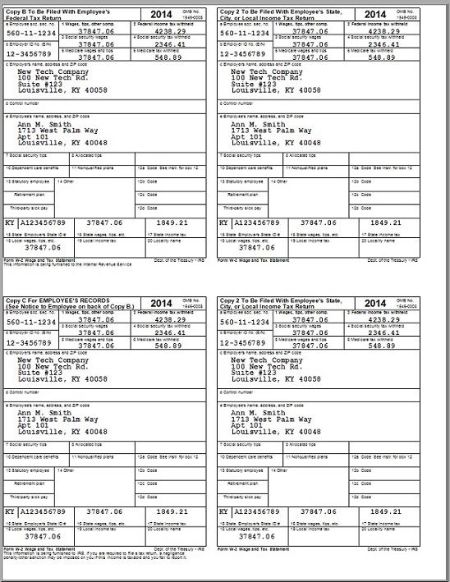
W-2

Slide 4
1099-INT

Slide 5
1099-DIV

Slide 6
1099-MISC

Slide 7
1099-R

Slide 8
SSA-1099

